Slide 1
EE-2003 Computer Organization & Assembly Language
INSTRUCTOR
Engr. Aashir Mahboob
Lecturer, Department of Computer Science
Office: Room No: 16, Opposite HoD (CS) Office
FAST NUCES (Karachi)
Aashir.mahboob@nu.edu.pk

Slide 2
CHAPTER No: 7
INTEGER ARITHMETIC

Slide 3
OUTLINES
•Shift and Rotate Instructions
•Multiplication and Division Instructions

Slide 4
•Bit manipulation is an intrinsic part of computer graphics, data encryption, and hardware manipulation.
•Bit shifting means to move bits right and left inside an operand.
•Shift and Rotate instructions affect the overflow and carry flags.

Slide 5
Shift and Rotate Instructions
Logical vs Arithmetic Shifts
SHL and SHR Instruction
SAL and SAR Instructions
ROL and ROR Instruction
RCL and RCR Instructions
SHLD/SHRD Instructions

Slide 6
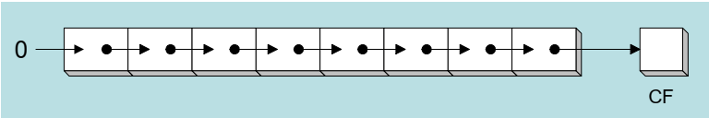
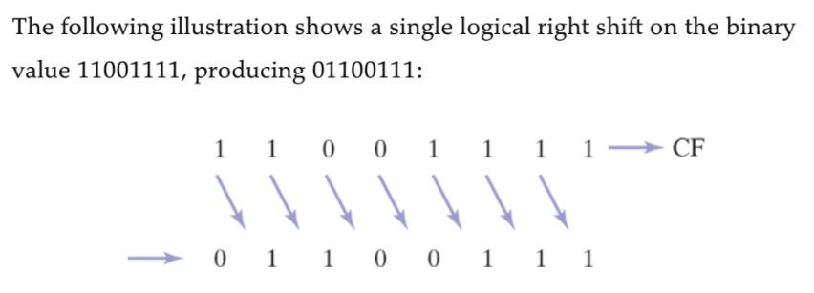
Logical vs Arithmetic shifts
A logical shift fills the newly created bit position with zero.
each bit is moved to the next lowest bit position, and the newly created bit position is filled with zero.

Slide 7
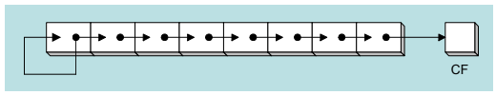
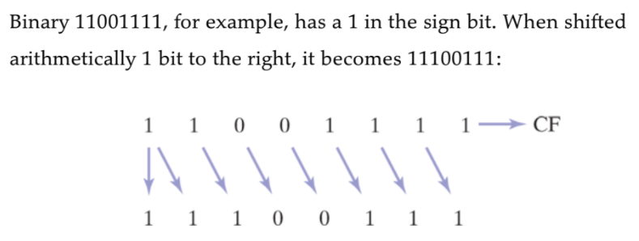
Logical vs Arithmetic shifts
An arithmetic shift fills the newly created bit position with a copy of number s sign bit:.

Slide 8
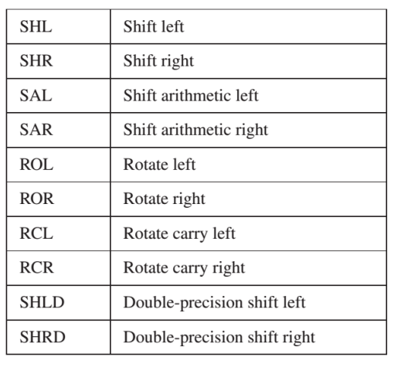
SHIFT & ROTATE INSTRUCTIONS

Slide 9
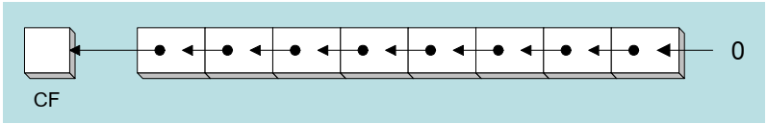
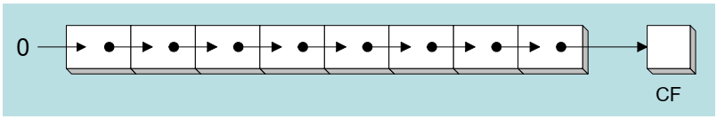
SHL & SHR Instruction
The SHL (shift left) instruction performs a logical left shift on the destination operand, filling the lowest bit with 0
The SHR (shift right) instruction performs a logical right shift on the destination operand, the highest bit position is filled with a zero

Slide 10
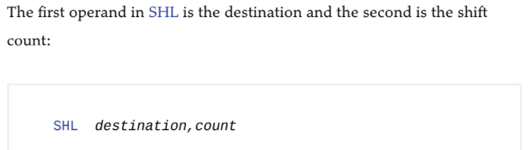
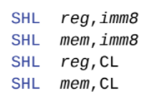
SHL & SHR Instruction
The following lists the types of operands permitted by this instruction:
x86 processors permit imm8 to be any integer between 0 and 255.
Alternatively, the CL register can contain a shift count.

Slide 11

EXAMPLE

Slide 12


Application
Bitwise multiplication is performed when you shift a number’s bits in leftward direction (toward the MSB).
Example:
•SHL can perform multiplication by powers of 2.
•Shifting any operand left by n bits multiplies the operand by 2^n.
•For example, shifting the integer 5 left by 1 bit yields the product of 5 X 2^1 = 10.
•If binary 00001010 (decimal 10) is shifted left by two bits, the result is the same as multiplying 10 by 2^2

Slide 13



SHL & SHR Instruction
SHR Instruction performs a logical right shift on the destination operand, replacing the highest bit with a 0.
The lowest bit is copied into the Carry flag.

Slide 14

Application
Bitwise division is performed when you shift a number’s bits in rightward direction (toward the LSB).
Shifting an unsigned integer right by n bits divides the operand by 2^n .
In the following statements, we divide 32 by 2^1 , producing 16.

Slide 15
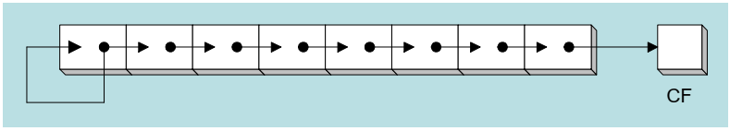

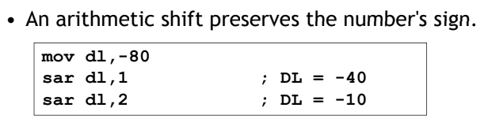
SAL & SAR Instruction
SAL (shift arithmetic left) is identical to SHL.
SAR (shift arithmetic right) performs a right arithmetic shift on the destination operand
An arithmetic shift preserves the number s sign 's sign

Slide 16
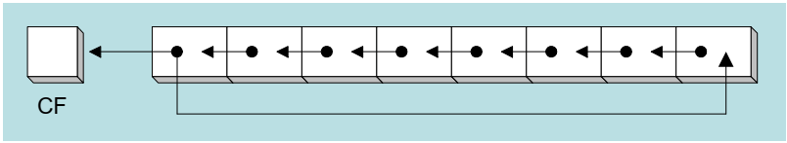
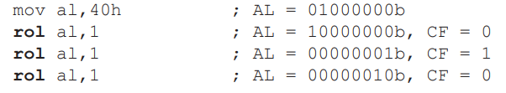
ROL & ROR Instruction
ROL (rotate) shifts each bit to the left
The highest bit is copied into both the Carry flag and into the lowest bit
No bits are los shift preserves the number s sign 's sign
•When using a rotation count greater than 1, the Carry flag contains the last bit rotated out of the MSB position.

Slide 17
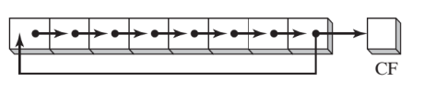


ROL & ROR Instruction
ROR Instruction shifts each bit to the right and copies the lowest bit into the Carry flag and the highest bit position (MSB).

Slide 18
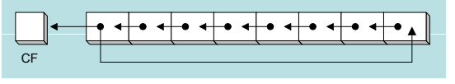
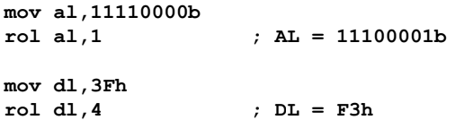
ROL & ROR Instruction
ROL (rotate) shifts each bit to the left.
The highest bit is copied into both the Carry flag and into the lowest bit.
No bits are lost.

Slide 19
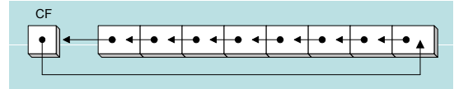
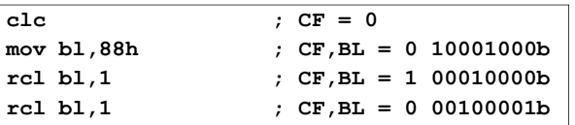
RCL & RCR Instruction
RCL (rotate carry left) shifts each bit to the left
Copies the Carry flag to the least significant bit
Copies the most significant bit to the Carry flag

Slide 20
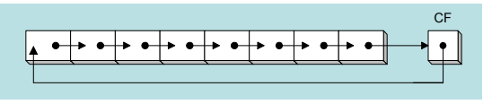

RCL & RCR Instruction
RCR (rotate carry right) shifts each bit to the right
Copies the Carry flag to the most significant bit
Copies the least significant bit to the Carry flag

Slide 21

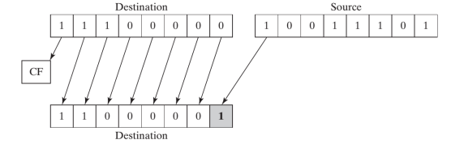
SHLD AND SHRD INSTRUCTIONS
The SHLD (shift left double) instruction shifts a destination operand a given number of bits to the left.
The bit positions opened up by the shift are filled by the most significant bits of the source operand.

Slide 22

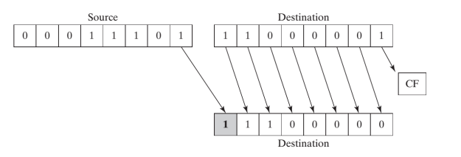
SHLD AND SHRD INSTRUCTIONS
The SHRD (shift right double) instruction shifts a destination operand a given number of bits to the right.
The bit positions opened up by the shift are filled by the least significant bits of the source operand:

Slide 23
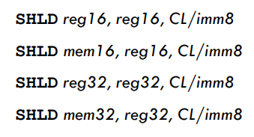
SHLD AND SHRD INSTRUCTIONS
The source operand is not affected, but the Sign, Zero, Auxiliary, Parity, and Carry flags are affected.
The following instruction formats apply to both SHLD and SHRD:

Slide 24
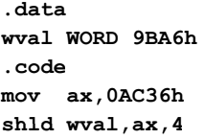
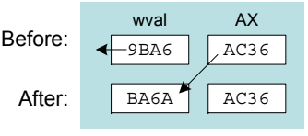
SHLD example
Shift wval 4 bits to the left and replace its lowest 4 bits with the high 4 bits of AX:

Slide 25
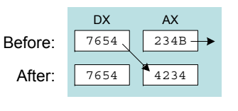

SHRD example
Shift AX 4 bits to the right and replace its highest 4 bits with the low 4 bits of DX:

Slide 26
Shift and rotate applications
Shifting Multiple Doublewords
Binary Multiplication
Displaying Binary Bits
Isolating a Bit String

Slide 27


Shifting multiple doublewords
Programs sometimes need to shift all bits within an array as one might when moving a within an array, as one might when moving a bitmapped graphic image from one screen location to another.
The following shifts an array of 3 doublewords 1 bit to the right:

Slide 28
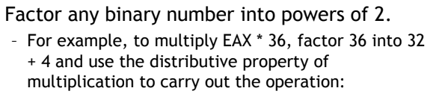
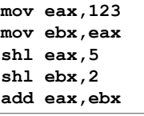
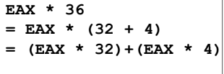
Binary multiplication
We already know that SHL performs unsigned multiplication efficiently when the multiplier is a power of 2.

Slide 29
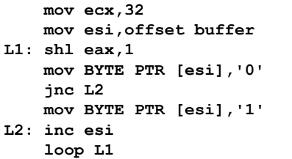
Displaying binary bits
Algorithm: Shift MSB into the Carry flag; If CF = 1,
append a “1” character to a string; otherwise append a "0" character. Repeat in a loop, 32 times.

Slide 30
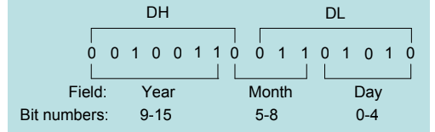
Isolating a bit string
The MS-DOS file date field packs the year (relative to 1980), month and , a day into 16 bits:

Slide 31

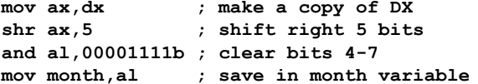
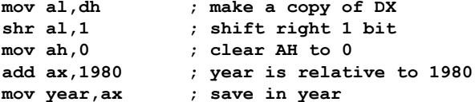
Isolating a bit string

Slide 32
MULTIPLICATION AND DIVISION INSTRUCTIONS
In 32-bit mode, integer multiplication can be performed as a 32-bit, 16-bit, or 8-bit operation.
The process of multiplication and division is different for signed and unsigned numbers, so there are different Instructions for signed and unsigned multiplication and division.
The MUL and IMUL instructions perform unsigned and signed integer multiplication, respectively.
The DIV instruction performs unsigned integer division, and IDIV performs signed integer division.

Slide 33
Signed Vs Unsigned Multiplication
Suppose we want to multiply the eight-bit numbers 10000000 and 11111111.
Interpreted as unsigned numbers, they represent 128 and 255; respectively. The product is 32,640.
However, taken as signed numbers, they represent-128 and -1, respectively; and the product is 128.
Thus signed and unsigned numbers must be treated differently.

Slide 34
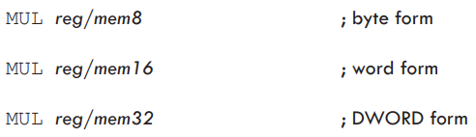
MUL INSTRUCTION
•In 32-bit mode, the MUL (unsigned multiply) instruction comes in three versions:
The first version multiplies an 8-bit operand by the AL register.
The second version multiplies a 16-bit operand by the AX register
Third version multiplies a 32-bit operand by the EAX register.
•The multiplier and multiplicand must always be the same size, and the product is twice their size.

Slide 35
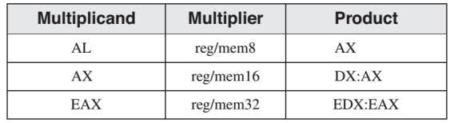
MUL INSTRUCTION
When AX is multiplied by a 16-bit operand, for example, the product is stored in the combined DX and AX registers.
• the high 16 bits of the product are stored in DX, and the low 16 bits are stored in AX.
The Carry flag is set if DX is not equal to zero, which lets us know that the product will not fit into the lower half of the implied destination operand.
•After MUL, CF/OF=0; if upper half of the result is zero; 1 otherwise.

Slide 36
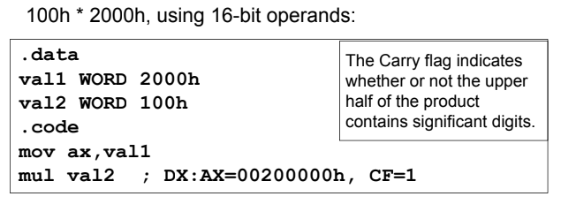
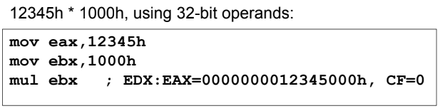
EXAMPLES

Slide 37
IMUL INSTRUCTION
•The IMUL (signed multiply) instruction performs signed integer multiplication.
•Unlike the MUL instruction, IMUL preserves the sign of the product.
•It does this by sign extending the highest bit of the lower half of the product into the upper bits of the product.
•The x86 instruction set supports three formats for the IMUL instruction: one operand, two operands, and three operands.

Slide 38
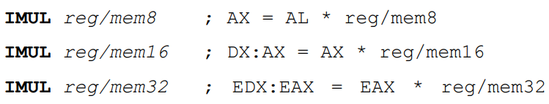
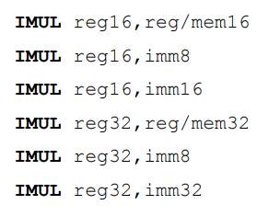
IMUL INSTRUCTION
•The one-operand formats store the product in AX, DX:AX, or EDX : EAX
. Two-Operand Formats (32-Bit Mode): stores the product in the first operand, which must be a register. The second operand (the multiplier) can be a register, a memory operand, or an immediate value:

Slide 39
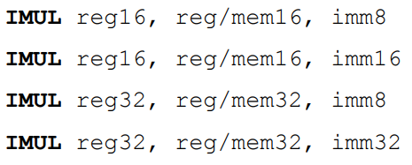
IMUL INSTRUCTION
The two-operand formats truncate the product to the length of the destination. If significant digits are lost, the Overflow and Carry flags are set.
•The three-operand formats in 32-bit mode store the product in the first operand. The second operand can be a 16-bit register or memory operand, which is multiplied by the third operand, an 8- or 16-bit immediate value:

Slide 40

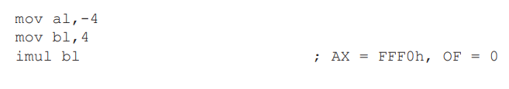
IMUL INSTRUCTION
•After IMUL, CF/OF = 0, if the upper half of the result is the sign extension of the lower half; CF/OF = 1 otherwise
• This means that the bits of the upper half are the same as the sign bit of the lower half.

Slide 41
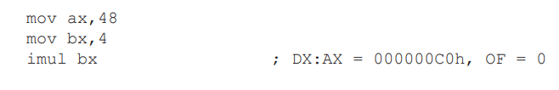
IMUL INSTRUCTION
• The following instructions multiply 48 by 4, producing +192 in DX:AX. DX is a sign extension of AX, so the Overflow flag is clear:

Slide 42
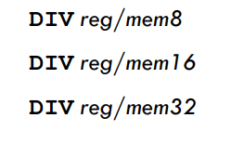
DIV INSTRUCTION
•In 32-bit mode, the DIV (unsigned divide) instruction performs 8-bit, 16-bit, and 32-bit unsigned integer division.
•Where the single reg/mem operand is divisor.
•When division is performed, we obtain two results, the quotient and the remainder.
• Quotient and remainder have the same size as the divisor.

Slide 43
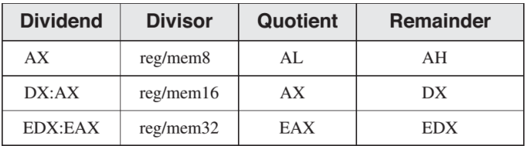
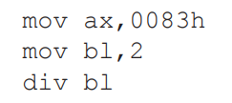
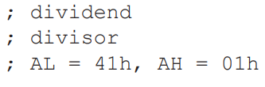
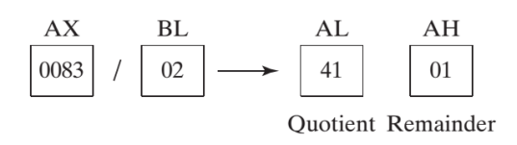
DIV INSTRUCTION

Slide 44
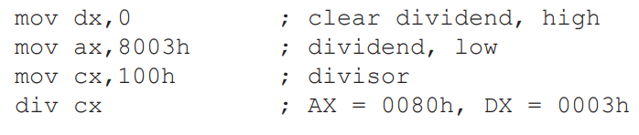
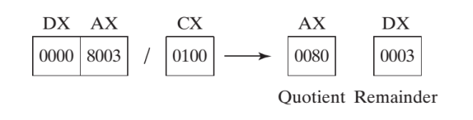
DIV INSTRUCTION
•In word (16-bit) division, the dividend is in DX:AX even if the actual dividend will fit in AX. In this case DX should be cleared:

Slide 45
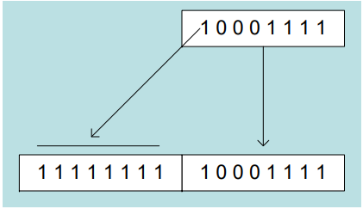
SIGNED INTEGER DIVISION
Signed integers must be sign-extended before division takes place.
fill high byte/word/doubleword with a copy of the low byte/word/doubleword's sign bit.
• For example, the high byte contains a copy of the sign bit from the low byte:

Slide 46
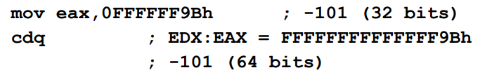
CBW, CWD, CDQ instructions
The CBW, CWD, and CDQ instructions provide important sign-extension operations:
•The CBW instruction (convert byte to word) extends the sign bit of AL into AH.
•The CWD (convert word to doubleword) instruction extends the sign bit of AX into DX.
•The CDQ (convert doubleword to quadword) instruction extends the sign bit of EAX into EDX.

Slide 47


IDIV INSTRUCTION
The IDIV (signed divide) instruction performs signed integer division, using the same operands as DIV.
•Before executing 8-bit division, the dividend (AX) must be completely sign-extended.
Example: 8-bit division of –48 by 5

Slide 48


IDIV INSTRUCTION
Example: 16-bit division of –48 by 5
Example: 32-bit division of –48 by 5

Slide 49

WHY SIGN EXTENSION IS NECESSARY

Slide 50

Divide overflow
• Divide overflow happens when the quotient is too large to fit into the destination.
It causes a CPU interrupt and halts the program. (divided by zero cause similar results).

Slide 51

Extended addition and subtraction
ADC Instruction
•The ADC (add with carry) instruction adds both a source operand and the contents of the Carry flag to a destination operand.
•The instruction formats are the same as for the ADD instruction, and the operands must be the same size:

Slide 52



ADC Instruction

Slide 53

Extended addition example
• Add two integers of any size
• Pass pointers to the addends (ESI EDI) and sum Pass pointers to the addends (ESI , EDI) and sum (EBX), ECX indicates the number of doublewords.

Slide 54

Extended addition example

Slide 55




SBB INSTRUCTION
•The SBB (subtract with borrow) instruction subtracts both a source operand and the value of the Carry flag from a destination operand.
•The possible operands are the same as for the ADC instruction

Slide 56


